Slide 1
How to write “good” code
AKA functions are amazing and you should use them everywhere
Yotam Sagiv
PNI Graduate Bootcamp
8/22/19

Slide 2
Who are you and why are you talking at me
2nd year
I like math (Daw) and neurons (Witten)
Pton undergrad (let’s chat classes)
Also your TA for 501A

Slide 3
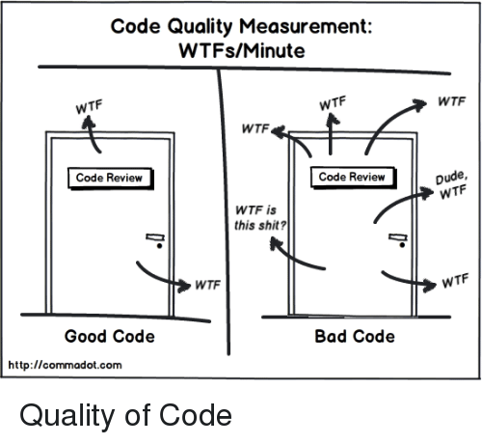
What makes code “good”?
What’s the function of code in our lives as neuroscientists?

Slide 4
What makes code “good”?
What’s the function of code in our lives as neuroscientists?
Data creation
Simulations from models
Experiment design + recording
Data analysis
Data visualization

Slide 5
What makes code “good”?
What’s the function of code in our lives as neuroscientists?
Data creation
Simulations from models
Experiment design + recording
Data analysis
Data visualization
Given these functions, what should we want from our code?

Slide 6
What makes code “good”?
What’s the function of code in our lives as neuroscientists?
Data creation
Simulations from models
Experiment design + recording
Data analysis
Data visualization
Given these functions, what should we want from our code?
Correctness
Writability
Readability

Slide 7
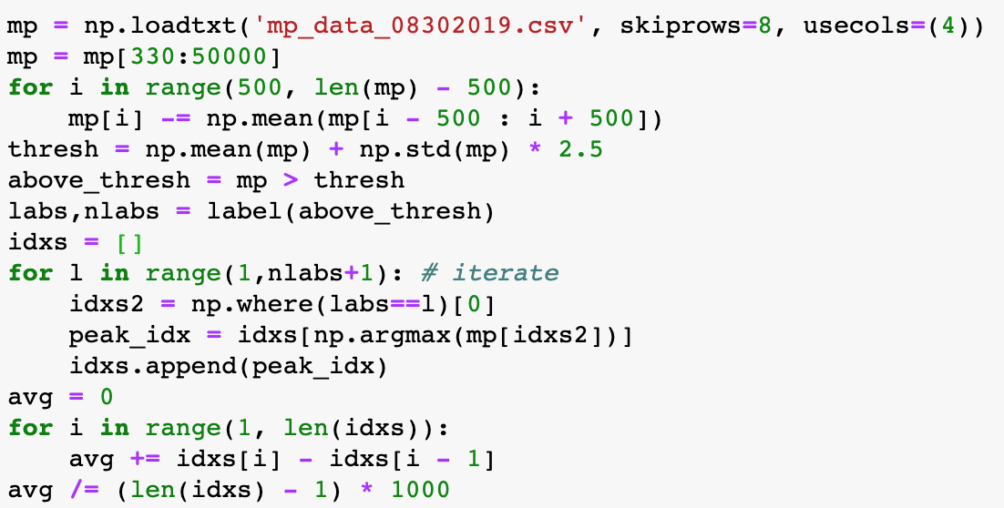

Who can tell what this code does?

Slide 8
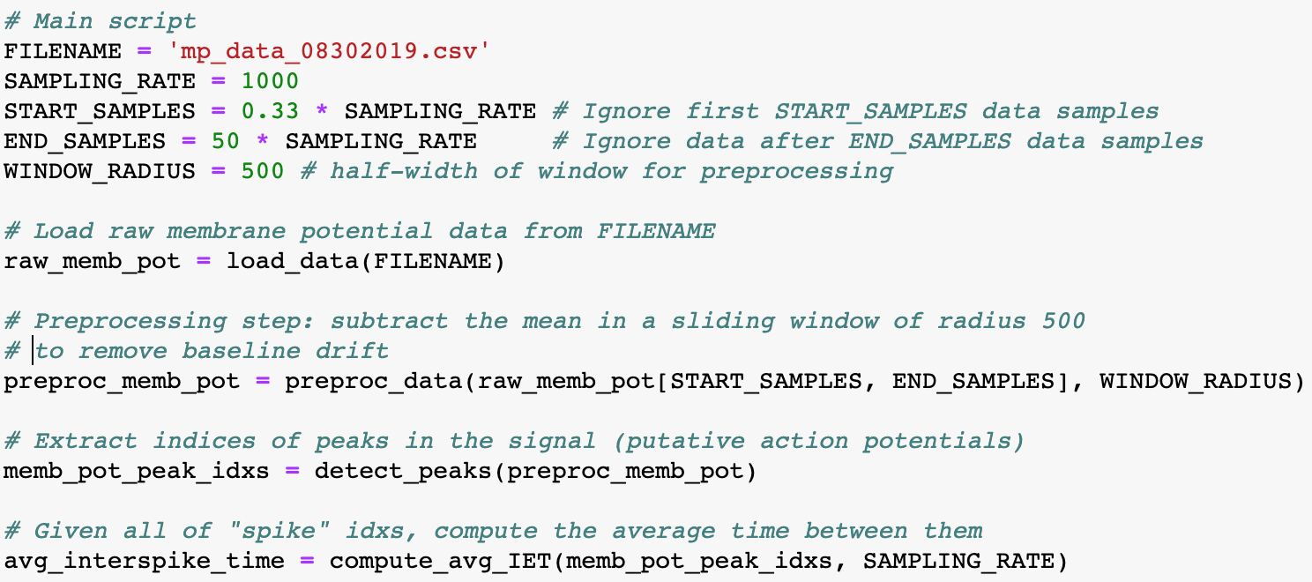

Who can tell what this code does?

Slide 9
Who can tell what this code does?
16 lines of code 9 lines of code
18 w/ comments 73 w/ functions

Slide 10
Basic idea
Imposing clear, discernible structure on code makes it easy to reason about
Basic principle that makes code both writable and readable
Point of this talk: how to incorporate structure in code
Modularity
Abstraction
Communication

Slide 11
Modularity (aka functions are great)
Fundamentally: programs should be constructed by linking together many independent modules that each do only a single thing

Slide 12
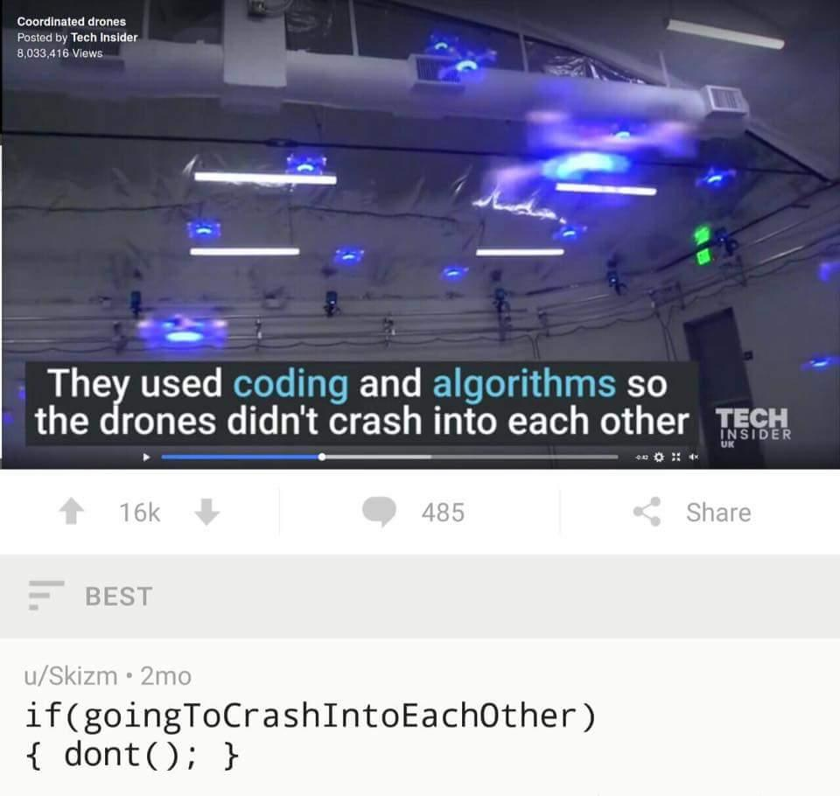

Slide 13
Modularity
Fundamentally: programs should be constructed by linking together many independent modules that each do only a single thing
Why?
Explicit how data is being transformed
Separates higher-order logic from implementation details
Main script
Function 1
Function 2
Function 3
Function 4
Function 5

Slide 14
Modularity: IST example
Data processing steps all at once
Unclear where one transformation stops
and the next begins
Clear how data is transformed
General logic flow discernible directly from function names
Know exactly where to change code if details need to be adjusted
Notes:
SHOWER JOKE LOL

Slide 15
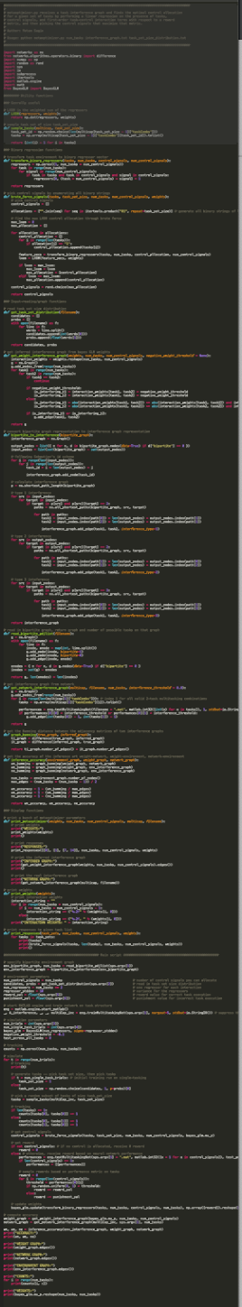
Structure of a modular program
# Import statements
import numpy as np
import pandas as pd
…
# Definition of helper functions
def function1(...):
…
def function2(...):
…
…
# Main script
X = 5
Y = 17
Z = function1(x, y)
...
Imports (~5 lines)
Functions (~300)
Main script (~80)

Slide 16
Modularity: a practical approach
Rarely obvious what the best way to modularize code is
Basic trick
Write down algorithm in your natural language of choice (e.g. in comments!)
For every verb you should have a function
Notes:
Exercises (I should do one of these live)
Write “code” that implements a “bridge-building” algorithm. This requires:
Load specification from client.
Derive materials needed from specs.
Compute cost of materials. If too high, send an email back to client lambasting them. If not, purchase materials.
Given materials, build the bridge.
Write “code” that “plays” a guitar. This requires:
Load sheet music.
For every note in the sheet music, play the note
Write “code” that simulates the universe. This requires:
Loading a planetary/solar system.
For each timestep, compute gravitational forces between each pair of celestial bodies.
From force, compute acceleration.
From accelration, compute velocity.
From velocity, compute position.

Slide 17
Modularity: a practical approach
Rarely obvious what the best way to modularize code is
Basic trick
Write down algorithm is text (e.g. in comments!)
For every verb you should have a function
Ex. Load the data. Preprocess through sliding-window mean subtraction. Extract idxs of action potentials. Compute avg IST from AP idxs.
Notes:
Exercises (I should do one of these live)
Write “code” that implements a “bridge-building” algorithm. This requires:
Load specification from client.
Derive materials needed from specs.
Compute cost of materials. If too high, send an email back to client lambasting them. If not, purchase materials.
Given materials, build the bridge.
Write “code” that “plays” a guitar. This requires:
Load sheet music.
For every note in the sheet music, play the note
Write “code” that simulates the universe. This requires:
Loading a planetary/solar system.
For each timestep, compute gravitational forces between each pair of celestial bodies.
From force, compute acceleration.
From accelration, compute velocity.
From velocity, compute position.

Slide 18
Modularity: IST example
Notes:
SHOWER JOKE LOL

Slide 19
Modularity: a practical approach
Rarely obvious what the best way to modularize code is
Basic trick
Write down algorithm is text (e.g. in comments!)
For every verb you should have a function
Ex. Load the data. Preprocess through sliding-window mean subtraction. Extract idxs of action potentials. Compute avg ISI from AP idxs.
Neat: can (approximately) build program structure (mostly) independent of details
Notes:
Exercises (I should do one of these live)
Write “code” that implements a “bridge-building” algorithm. This requires:
Load specification from client.
Derive materials needed from specs.
Compute cost of materials. If too high, send an email back to client lambasting them. If not, purchase materials.
Given materials, build the bridge.
Write “code” that “plays” a guitar. This requires:
Load sheet music.
For every note in the sheet music, play the note
Write “code” that simulates the universe. This requires:
Loading a planetary/solar system.
For each timestep, compute gravitational forces between each pair of celestial bodies.
From force, compute acceleration.
From acceleration, compute velocity.
From velocity, compute position.

Slide 20
Modularity: a review
Functions let you explicitly cast how you’re transforming your data
Isolated structures make editing easy since changes are localized

Slide 21
Abstraction
Fundamental idea: pieces of code should be written in a way that minimizes assumptions about the data they process
Why?
Protect your code against users (future-you is a user!)
Maximize flexibility (minimize work for future-you)
Notes:
The more abstract your code is, the more likely you’ll be able to reuse it
Create explicit assumptions for your functions -- easy to know when they will work in the future

Slide 22


Example 1 (IST)

Slide 23
Example 1 (IST)
Have to write window radius 4 times
Will need to edit 4 times if I ever decide to change it
Write it once
Will need to edit once if I ever decide to change it

Slide 24
Abstraction: a practical approach
Try to make as few assumptions about your data as possible
E.g. write a function that does sliding-window mean subtraction for a variable number of indices, rather than only 500
Rule of thumb: if your analysis relies on a constant, try to write a function that has it as a variable
Whatever assumptions you choose to keep, enforce
E.g. if your function accepts an array of ints, throw an error if it doesn’t receive an array of ints
Notes:
The more abstract your code is, the more likely you’ll be able to reuse it
Create explicit assumptions for your functions -- easy to know when they will work in the future

Slide 25
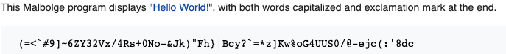
Communication
Reading code is really hard
Some of this will be outside your control
Good coding practices seek to communicate structure and purpose of code as clearly as possible

Slide 26
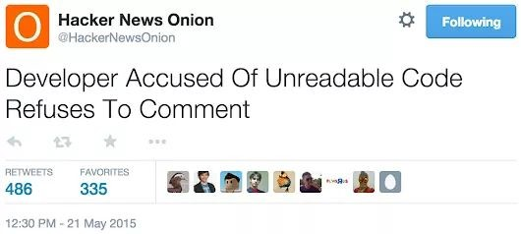
Comments
You can break most rules if you comment appropriately
^{But please don’t}
What things should you comment?
Purpose of blocks of code (why)
Breakdown of complicated lines (what)
When should you write comments?
Varies a little bit between different people
My take: why comments before code, what comments after code

Slide 27

Example 1 (IST)

Slide 28
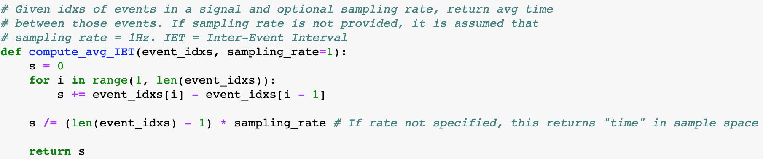
Example 1.5 (IST)

Slide 29
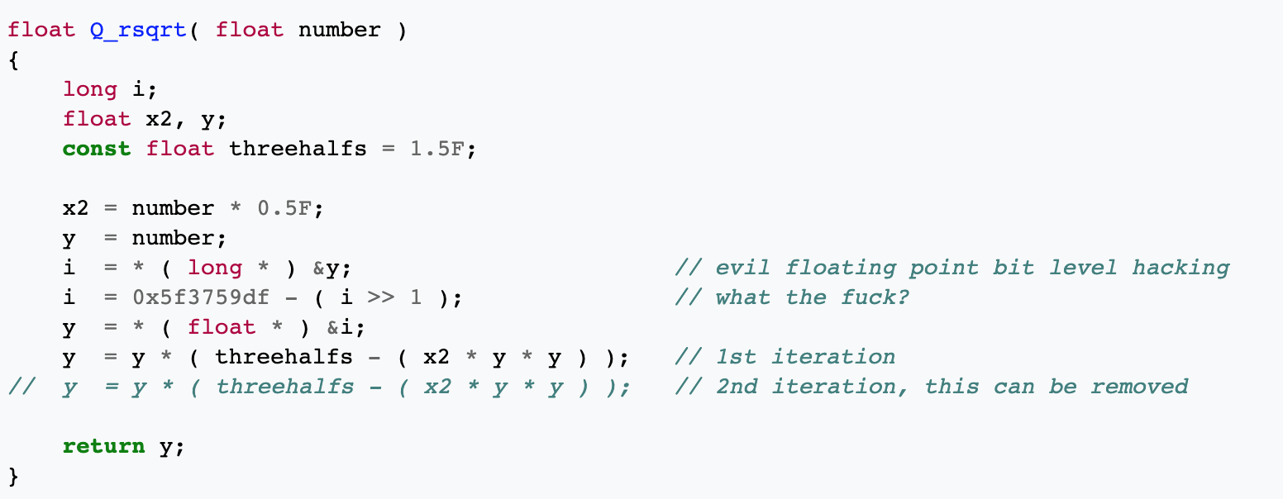
Example 2 (fast inverse square root)

Slide 30

Example 2 (fast inverse square root)

Slide 31
Example 3

Slide 32
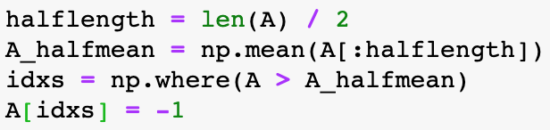
Clarity > Compactness
Shorter lines of code do not equate shorter execution time
Consequence: write code to optimize clarity, not compactness
Clear code is easier to think about
In practice, well-styled code will be longer than poorly-styled code

Slide 33
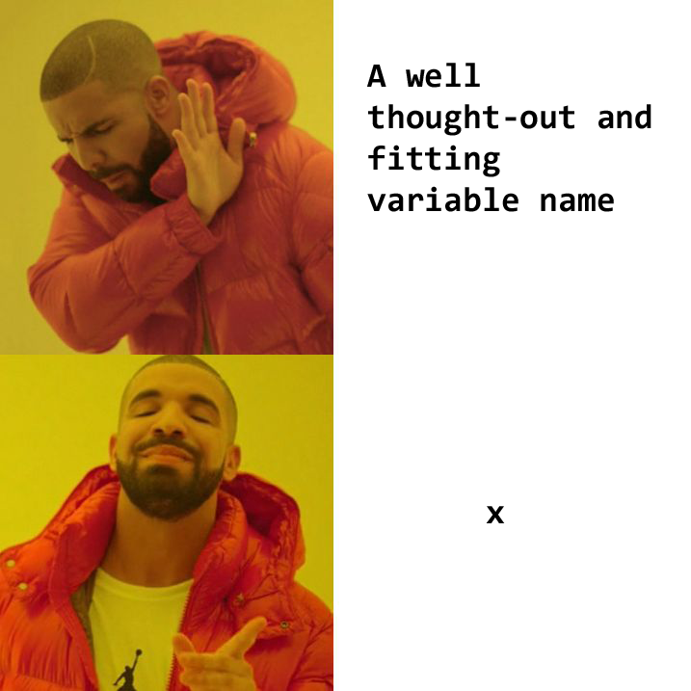
Bits and pieces
Always be informative
Variable names, function names
For each function, write down what its purpose is, what its assumptions are, and broadly speaking how it works
Jupyter notebooks
Ability to smoothly integrate text, code, and figures makes them great for demos and rapid prototyping
Dependencies between cells means that they’re generally bad for every other purpose
Style conventions
Pick one, stick with it
I like: snake_case for variables/functions, UPPERCASE for constants

Slide 34
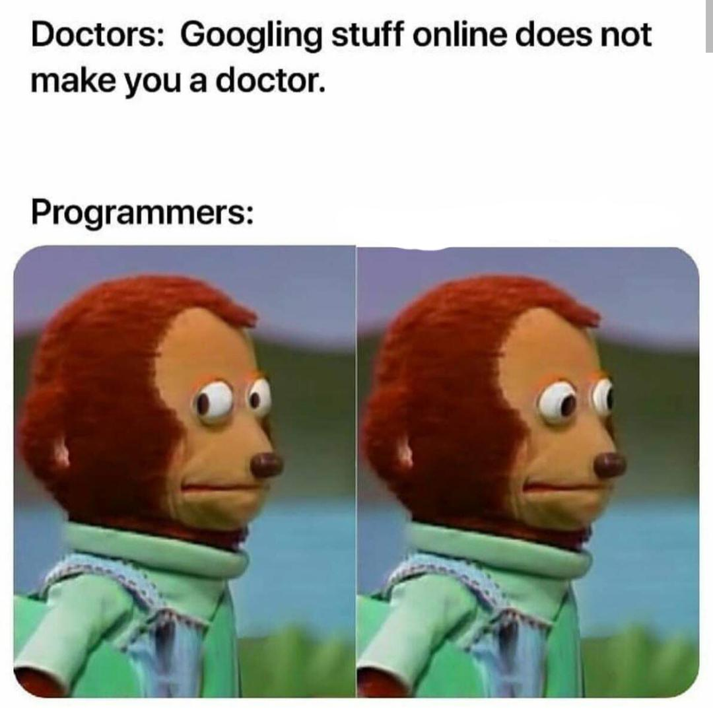
To wrap up...
Programming is hard
You can make it easier by following some basic principles
Isolate computations whenever you can (Modularity)
Try and write code that is as general as possible (Abstraction)
Whatever you do, document it (Communication)
Python has a rich community -- whatever you want has probably been done
Can save hours of time with appropriate Google skills
I’m always happy to talk about code structure

